Slide 1
Introduction to Computer Vision The Three R’s
Jitendra Malik

Slide 2
Moravec’s argument(1998) ROBOT: Mere Machine To Transcendent Mind
1 neuron = 1000 instructions/sec
1 synapse = 1 byte of information
Human brain then processes 10^14 IPS and has 10^14 bytes of storage
In 2000, we have 10^9 IPS and 10^9 bytes on a desktop machine
Assuming Moore’s law we obtain human level computing power in 2025, or with a cluster of 100 nodes in 2015.

Slide 3
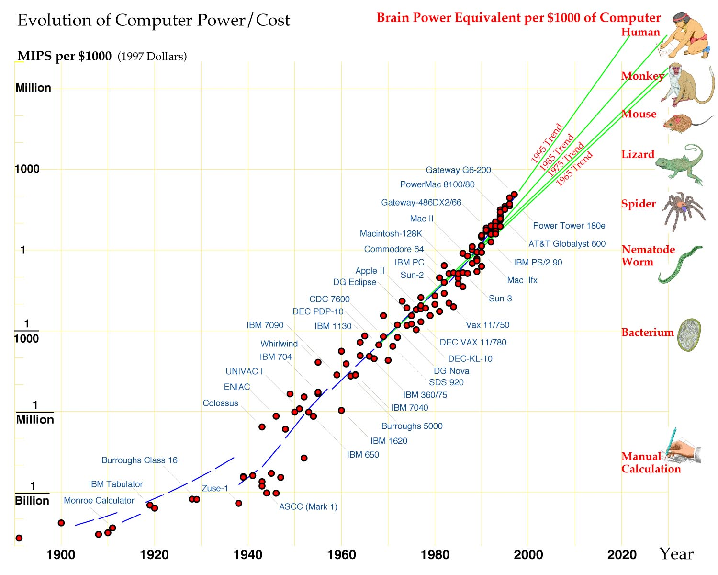

Slide 4
Embodied Cognition
Vision
(broadly,perception)
Motor Control
(broadly,planning)
Language
Semantic Reasoning

Slide 5
Phylogeny of Intelligence
The Cambrian period (543-490 million yrs ago) led to the emergence of wide variety of animal life. These animals had vision and locomotion capabilities.
Sensory systems provide great benefits only when accompanied by the ability to move - to find food, avoid predators etc.

Slide 6
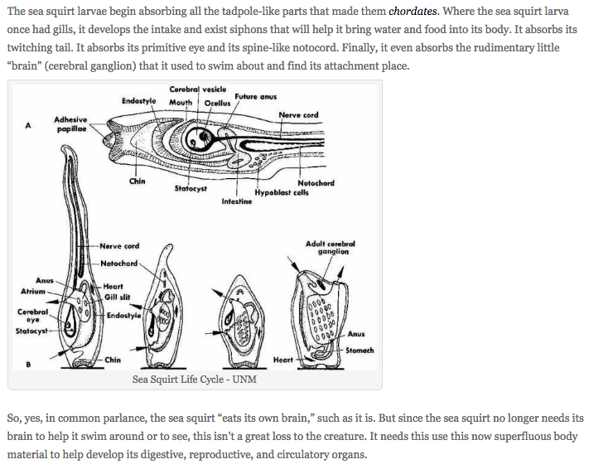
If you don’t need to move you don’t need an eye or a brain! https://goodheartextremescience.wordpress.com/2010/01/27/meet-the-creature-that-eats-its-own-brain/

Slide 7
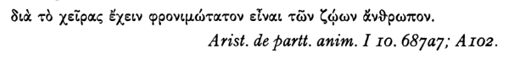
Hominid evolution in last 5 million years
Bipedalism freed the hand for tool making. Dexterous hands coevolved with larger brains.
Anaxagoras: It is because of his being armed with hands that man is the most intelligent animal

Slide 8
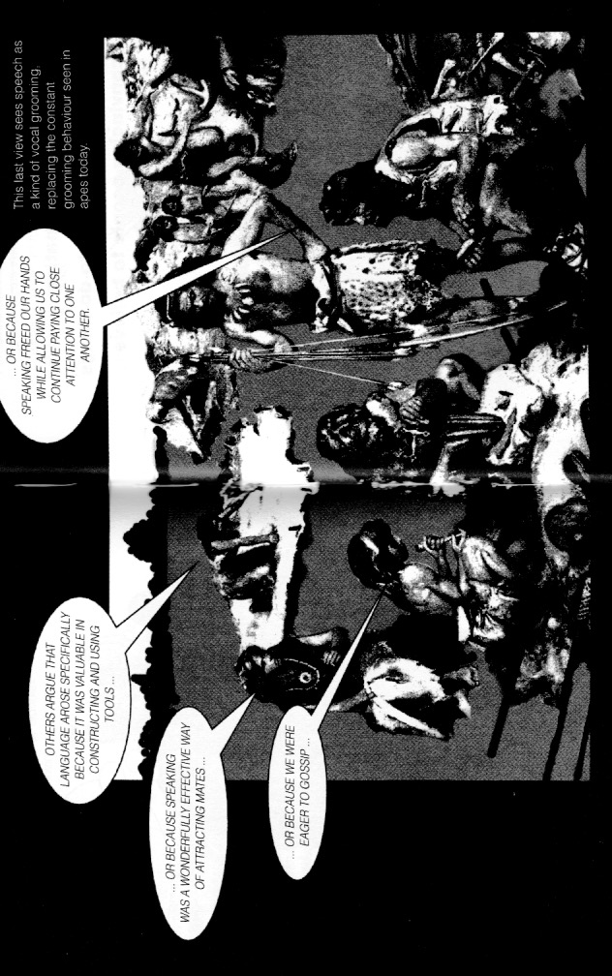
Origins of Language (from Trask)

Slide 9
The evolutionary progression
Vision and Locomotion
Manipulation
Language
Successes in AI seem to follow the same order!

Slide 10
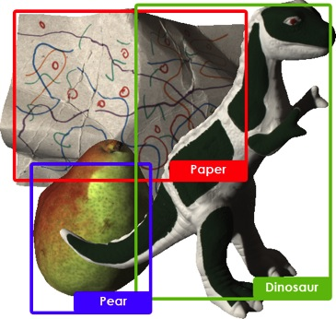

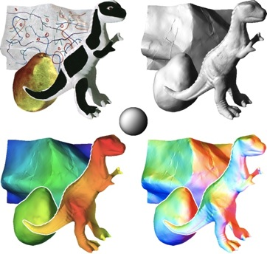
Recognition, Reconstruction & Reorganization
Recognition
Reorganization
Reconstruction

Slide 11
The Three R’s of Vision
Recognition
Reconstruction
Reorganization
Each of the 6 directed arcs in this diagram is a useful direction of information flow

Slide 12
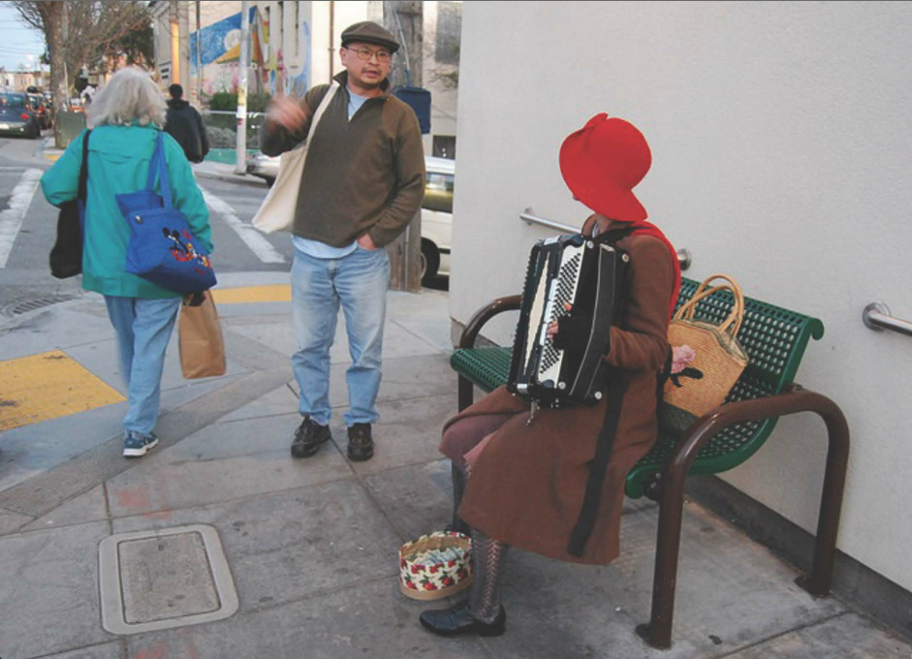

Slide 13
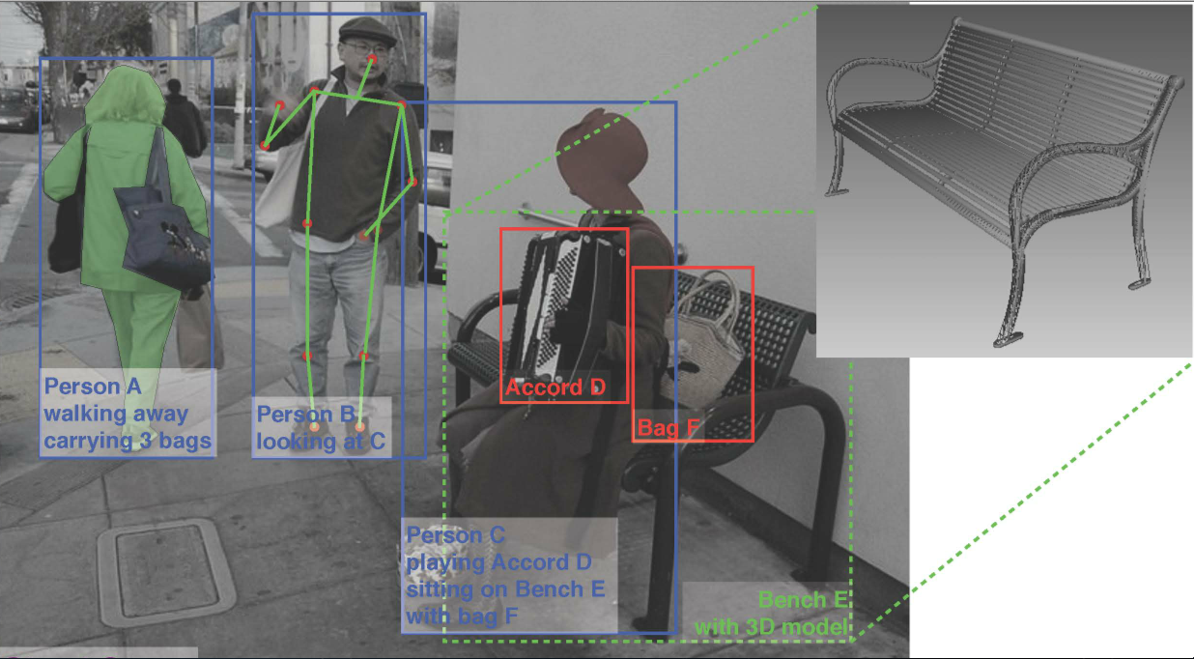
Some problems that we can solve…

Slide 14
Six decades of computer vision
1960s: Beginnings in artificial intelligence, image processing and pattern recognition
1970s: Foundational work on image formation: Horn, Koenderink, Longuet-Higgins …
1980s: Vision as applied mathematics: geometry, multi-scale analysis, probabilistic modeling, control theory, optimization
1990s: Geometric analysis largely completed, vision meets graphics, statistical learning approaches resurface
2000s: Significant advances in visual recognition
2010s: Progress continues, aided by the availability of large amounts of visual data and massive computing power. Deep learning has become pre-eminent

Slide 15
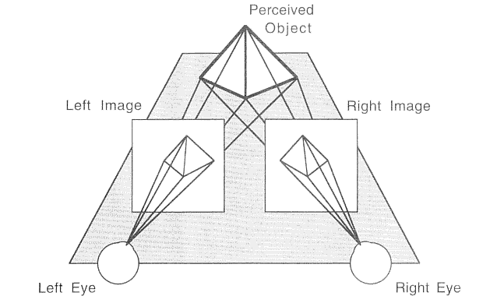
Binocular Stereopsis

Slide 16
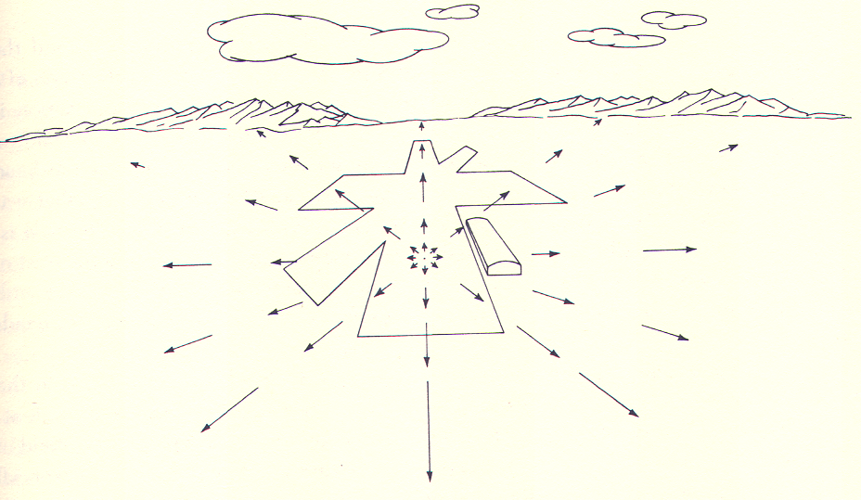
Optical flow is a basic cue for all animals

Slide 17
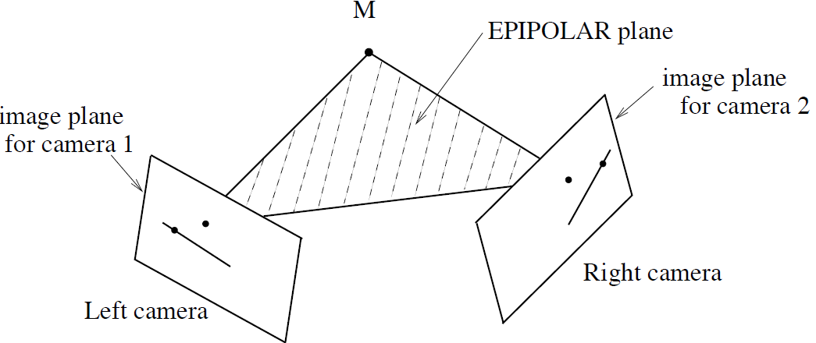
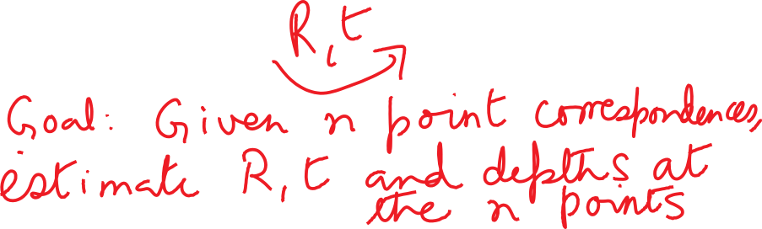
Epipolar geometry for cameras in general position

Slide 18
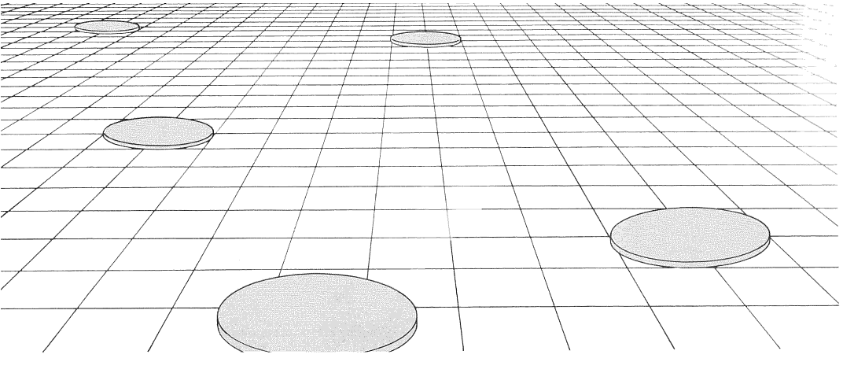
Some Pictorial Cues
Notes:
Here if we assume that the slabs are all of the same size and shape in the scene, then the apparent diminution of size on the image plane is a cue to changes in depth and surface slant. These kinds of grids are ubiquitous in Renaissance paintings.

Slide 19
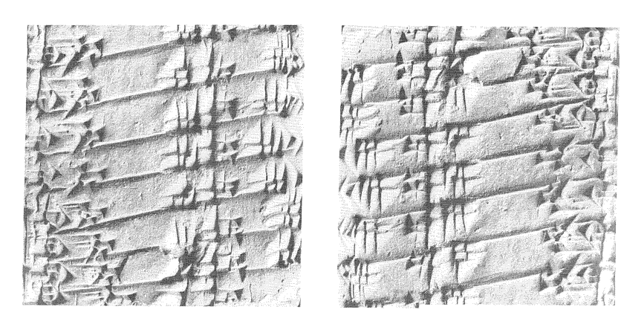
Shading
Notes:
The two halves of the figure correspond to exactly the same image, except that one has been rotated by 180 degrees. This changes our perception of ridges into grooves and vice versa. Humans make the assumption that the light comes from above.

Slide 20
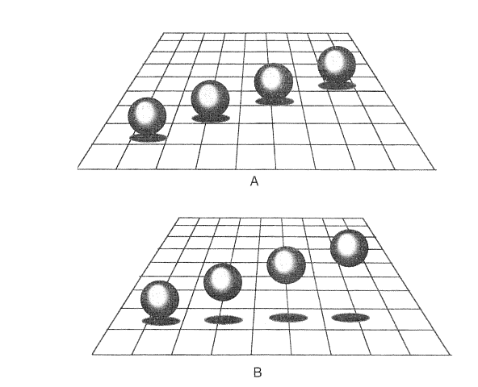
Cast Shadows
Notes:
By suitable manipulation of the position of the cast shadow, we can change the perception of whether the spheres are resting on the ground plane or not. This changes our perception of their depths. After Kersten and Knill.

Slide 21
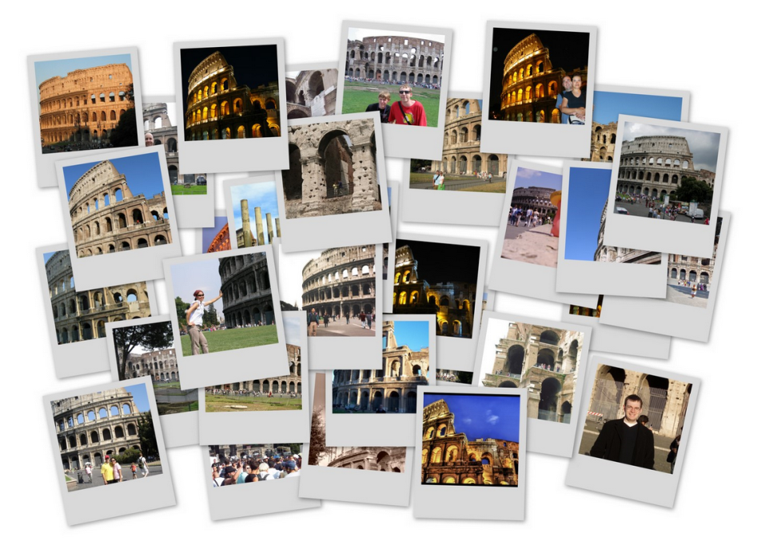
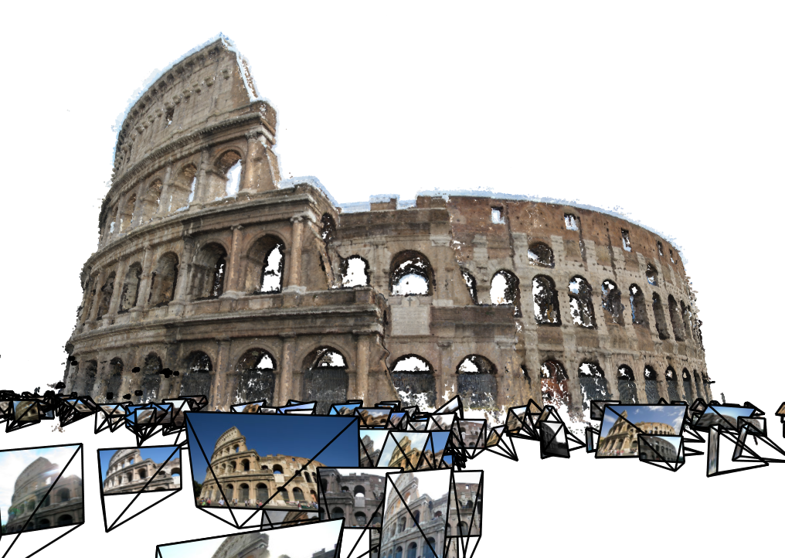
Reconstructing the world
Over the past 10 years, 3D modeling from images has made huge advances in scale, quality, and generality. We can reconstruct scenes…
… automatically from huge collections of photos downloaded from the Internet
Snavely, Seitz, Szeliski.
Reconstructing the World from Internet Photo Collections.
IJCV 2007

Slide 22
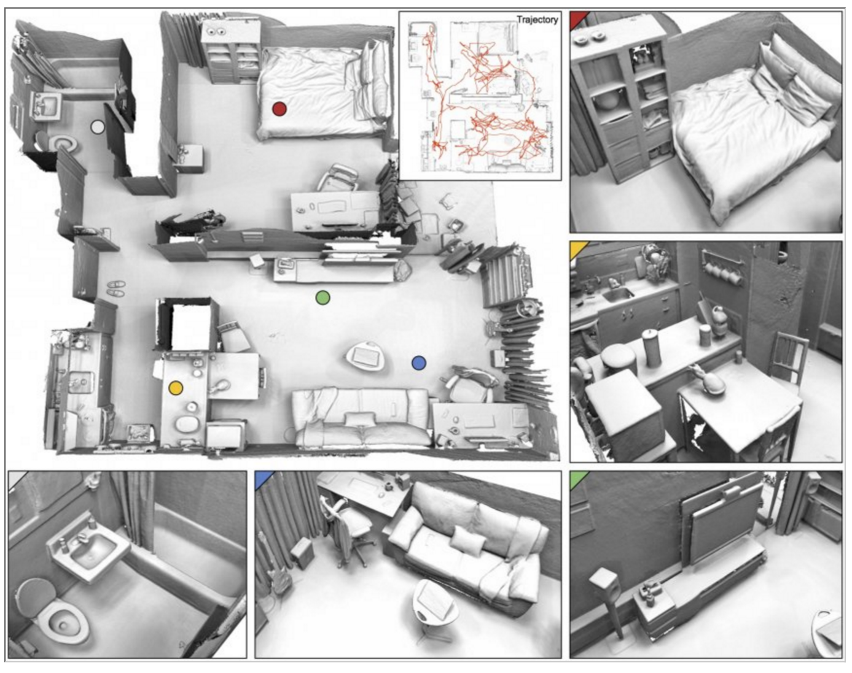
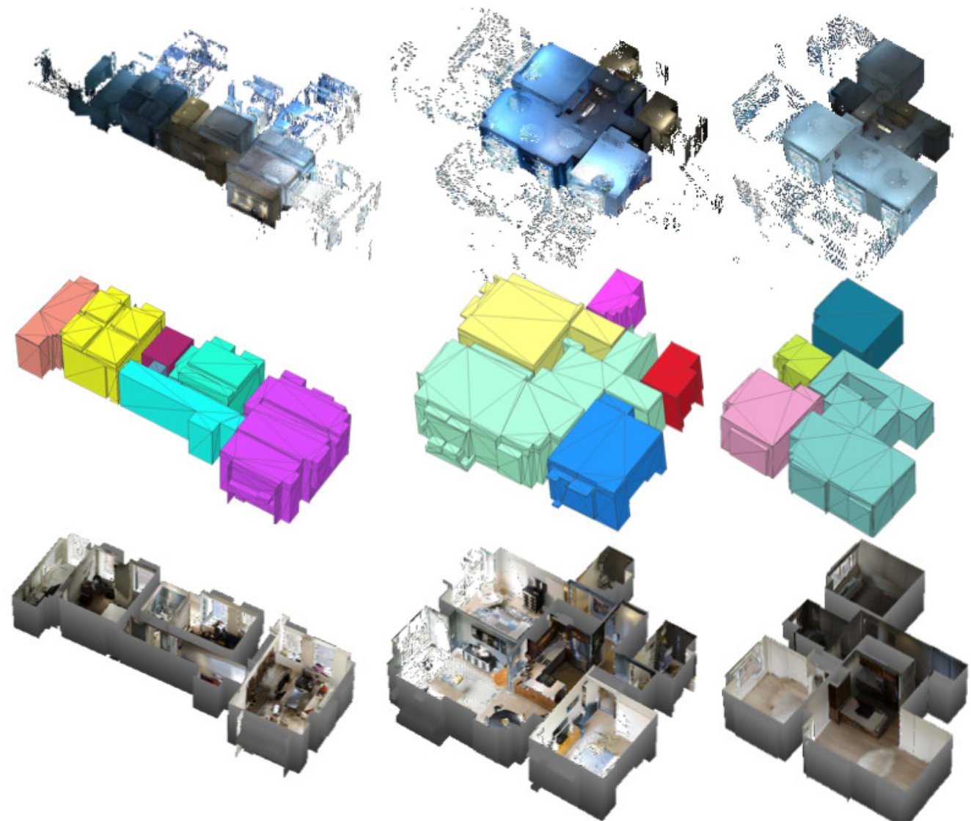
Reconstructing the great indoors…
… using Depth Cameras
… using Semantic Reconstruction of Rooms and Objects
point cloud
3D mesh
rendering
Choi, Zhou, Koltun.
Robust Reconstruction of Indoor Scenes.
CVPR 2015
Ikehata, Yan, Furukawa.
Structured Indoor Modeling.
ICCV 2015

Slide 23
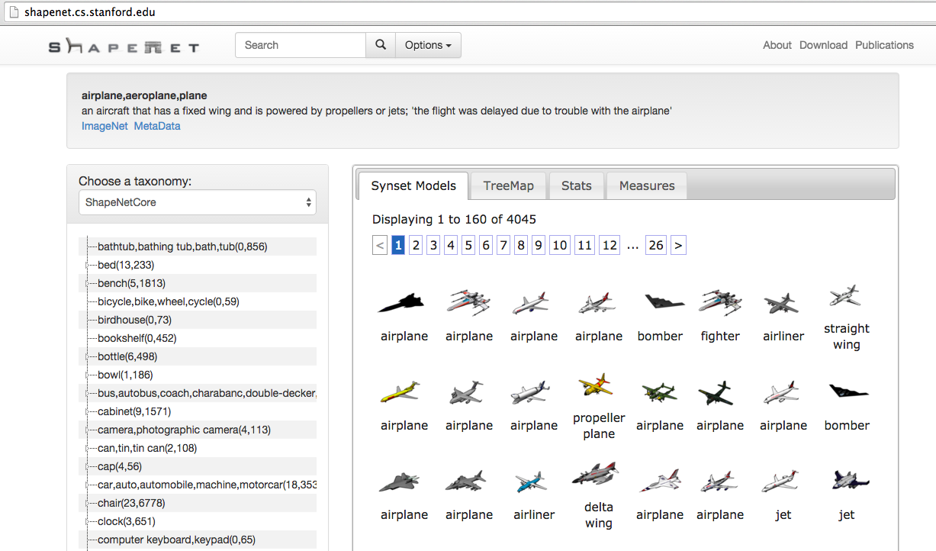
ShapeNet (Stanford & Princeton)

Slide 24
The Three R’s of Vision
Recognition
Reconstruction
Reorganization
We have explored category-specific 3D reconstruction.

Slide 25
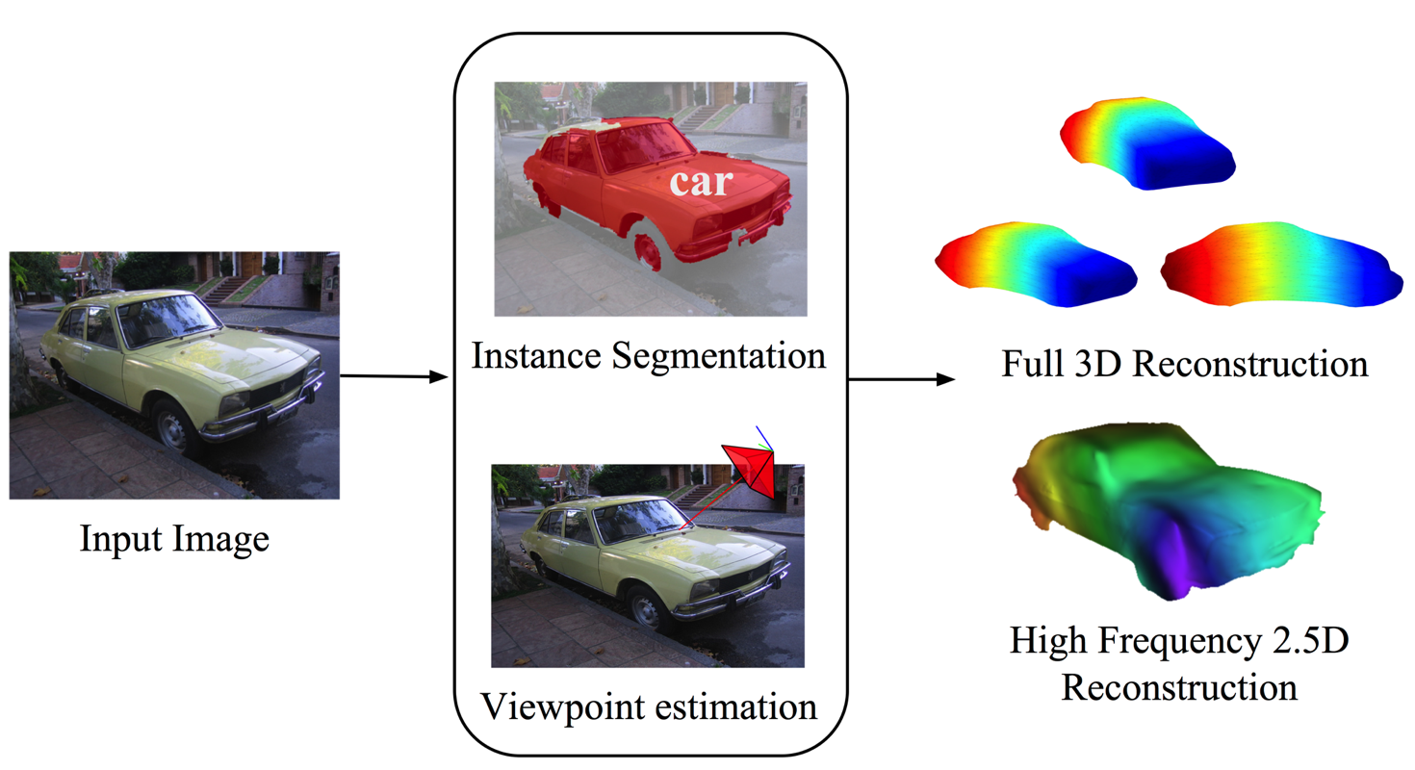
Category Specific Object Reconstruction
Kar, Tulisiani, Carreira & Malik
Notes:
Overview figure; Instance segmentation using SDS, Viewpoint estimation using Shubham’s CNN → 3D reconstruction and SIRFS refinement

Slide 26
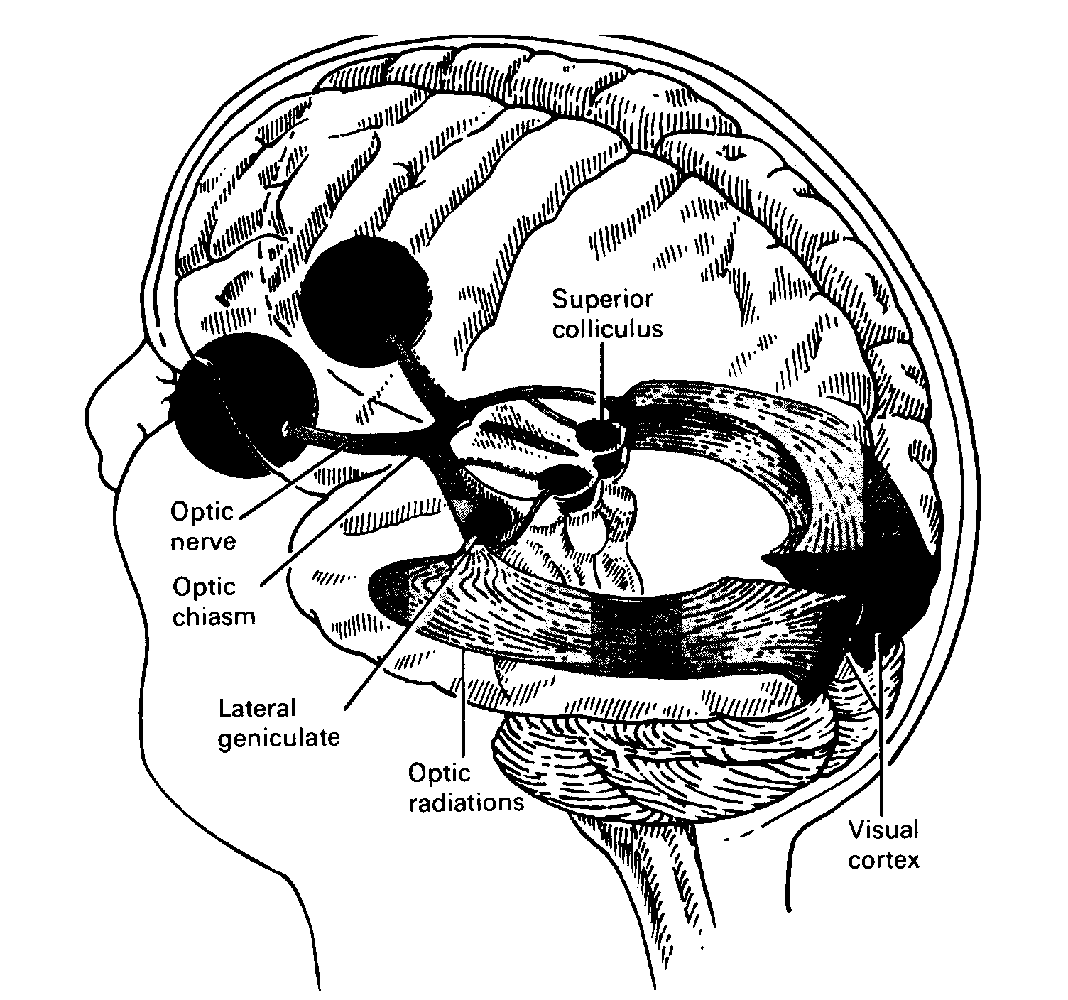
The Visual Pathway

Slide 27
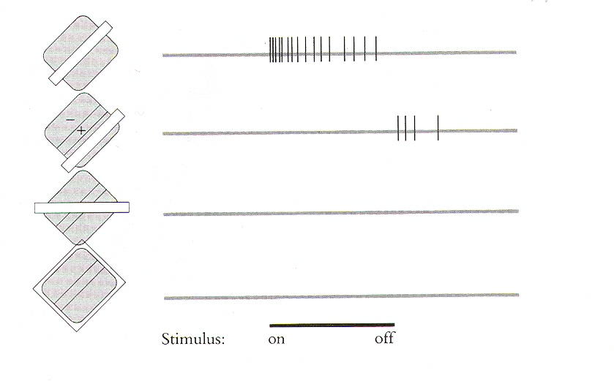
Hubel and Wiesel (1962) discovered orientation sensitive neurons in V1

Slide 28
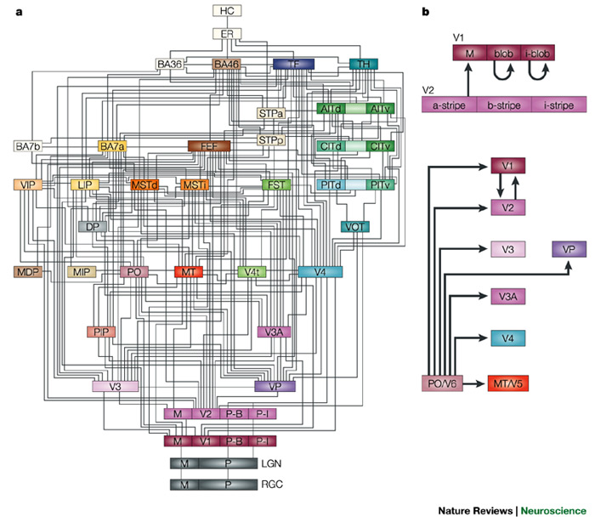
Block Diagram of the Primate Visual System
D. Van Essen Lab

Slide 29
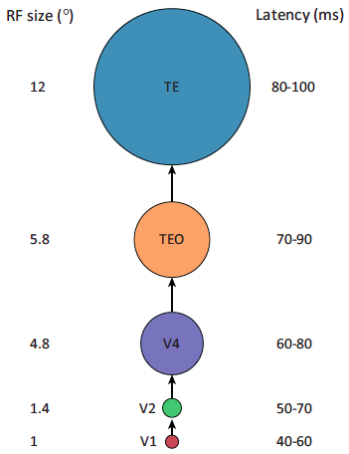
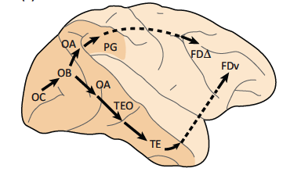
Feed-forward model of the ventral stream
Kravitz et al, Trends in Cognitive Science 2013

Slide 30
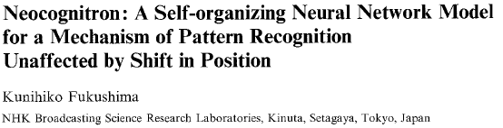
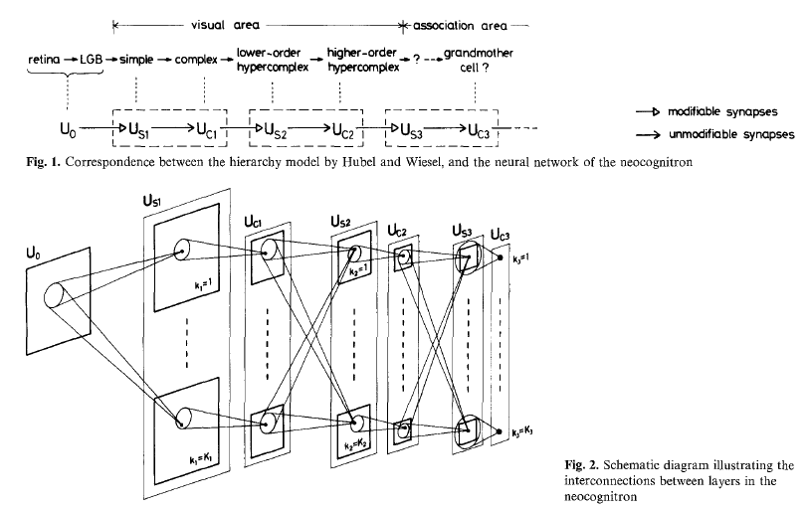

Slide 31
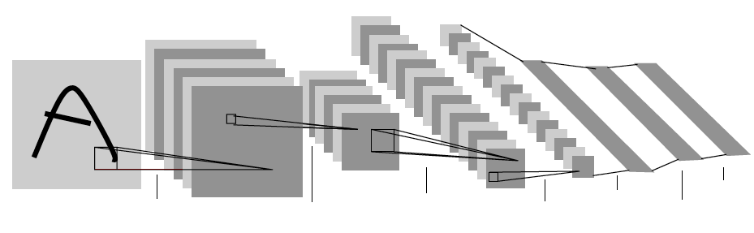
Convolutional Neural Networks (LeCun et al ) Used backpropagation to train the weights in this architecture
First demonstrated by LeCun et al for handwritten digit recognition(1989)
Applied in sliding window paradigm for tasks such as face detection in the 1990s.
However was not competitive on standard computer vision object detection benchmarks in the 2000s.
Krizhevsky, Sutskever & Hinton showed effectiveness for full image classification on ImageNet Challenge (2012)

Slide 32
The Three R’s of Vision
Recognition
Reconstruction
Reorganization
Each of the 6 directed arcs in this diagram is a useful direction of information flow

Slide 33
The Three R’s of Vision
Recognition
Superpixel assemblies as candidates
Reconstruction
Reorganization

Slide 34
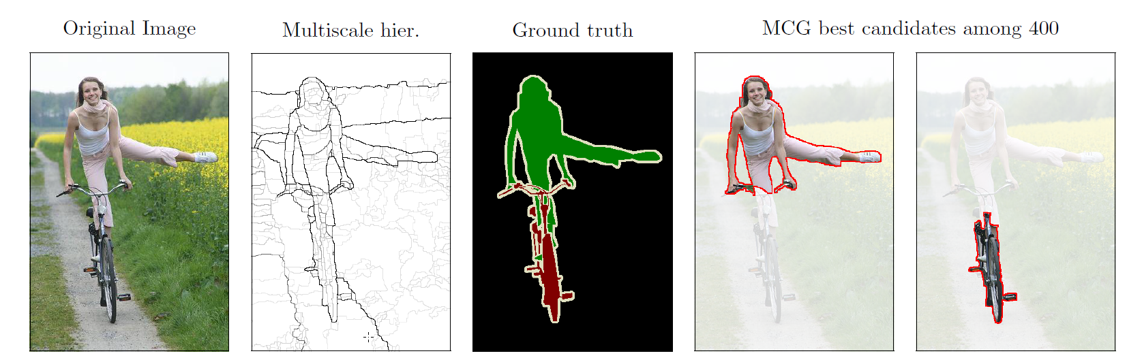
Bottom-up grouping as input to recognition
We produce superpixels of coherent color and texture first,
then combine neighboring ones to generate object candidates

Slide 35
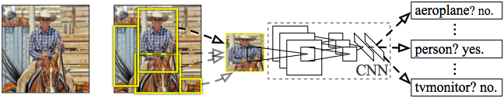
R-CNN: Regions with CNN features Girshick, Donahue, Darrell & Malik (CVPR 2014)
Input
image
Extract region
proposals (~2k / image)
Compute CNN
features
Classify regions
(linear SVM)
This and the Multibox work from Google showed
how to apply these architectures for object detection

Slide 36
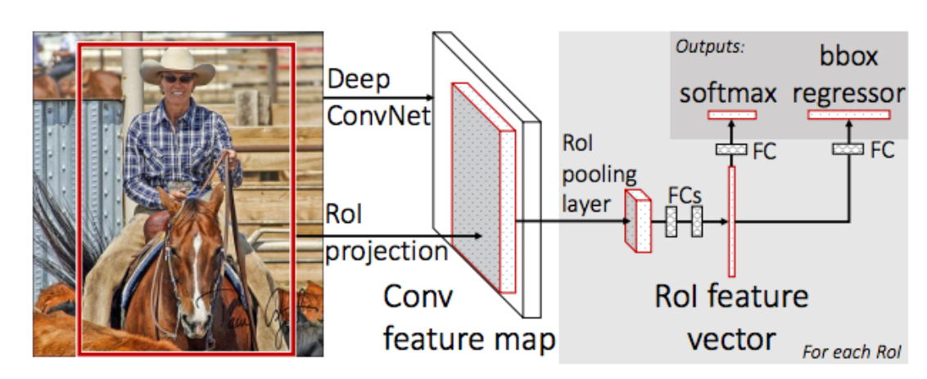
Fast R-CNN (Girshick, 2015) R-CNN with SPP features, no need to warp individual windows
There is also Faster R-CNN
which doesn’t require external proposals

Slide 37
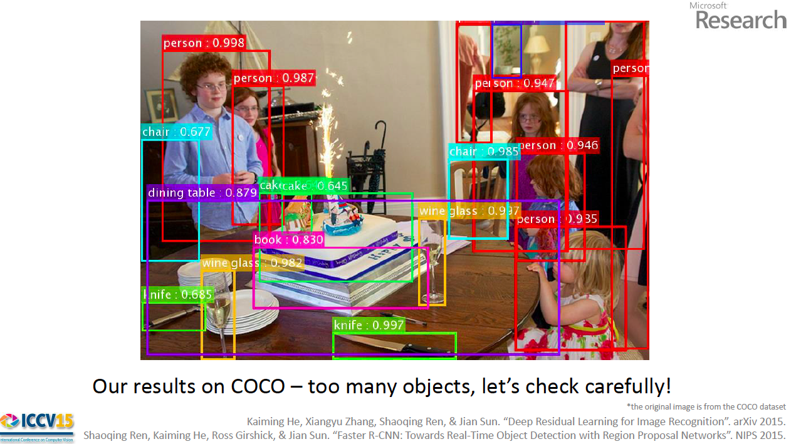
Current systems can do remarkably well in detecting objects

Slide 38
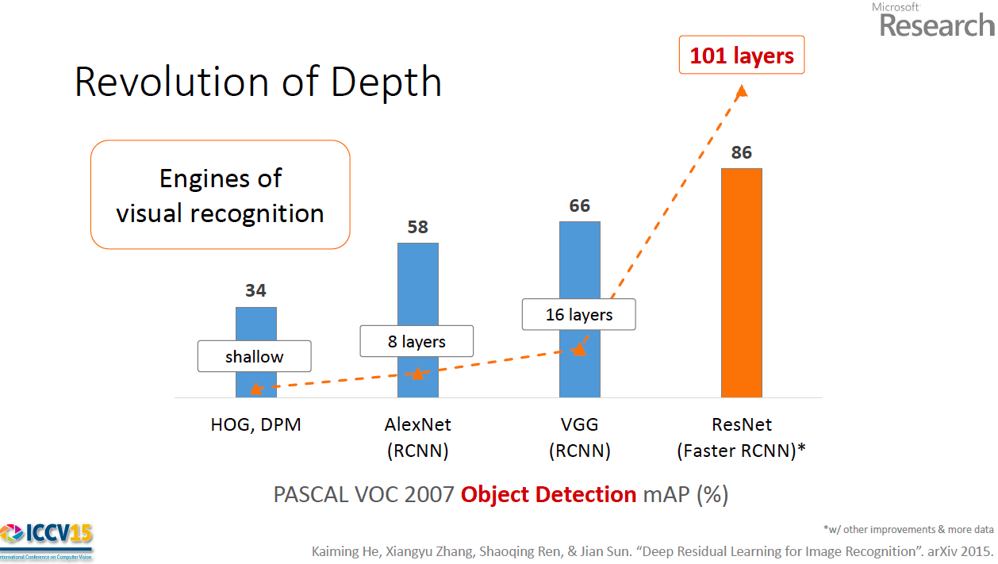

Slide 39
How about the other direction…
Recognition
Reconstruction
Reorganization

Slide 40
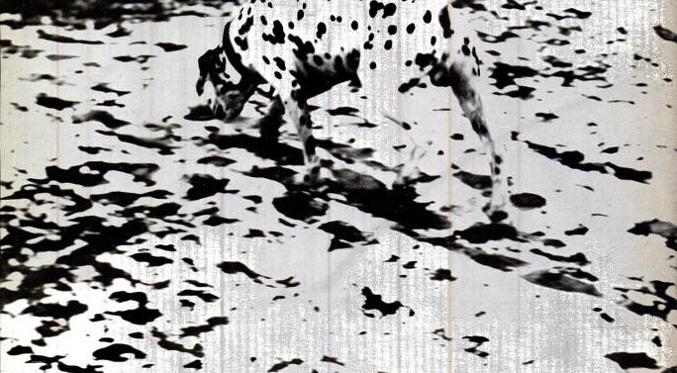
Recognition Helps Reorganization

Slide 41
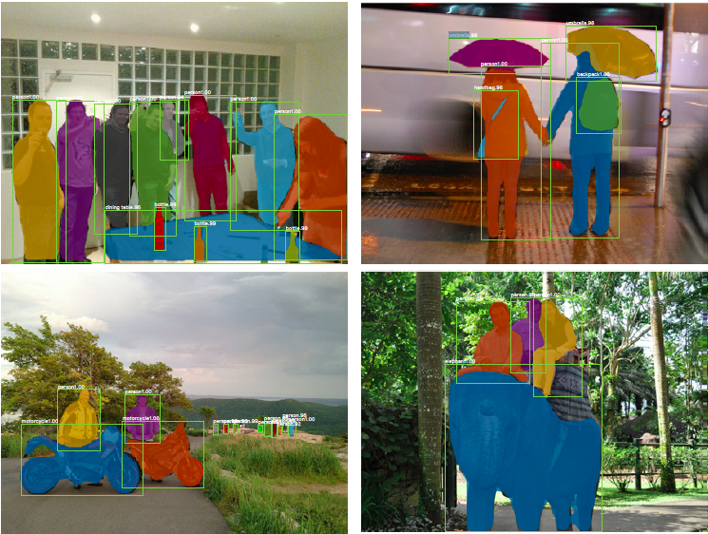
Mask R-CNN : He, Gkioxari, Dollar & Girshick (2017)

Slide 42
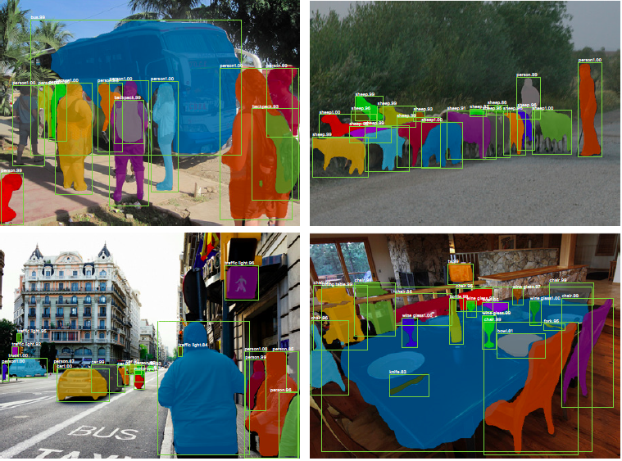

Slide 43
End-to-end Recovery of Human Shape and Pose
Angjoo Kanazawa, Michael Black, David Jacobs, Jitendra Malik
Notes:
White background, 4:3
One cover slide (Title, name, with our pictures)
Goal 12/15 arxiv.
Ablation study on the edge
Part segmentation

Slide 44
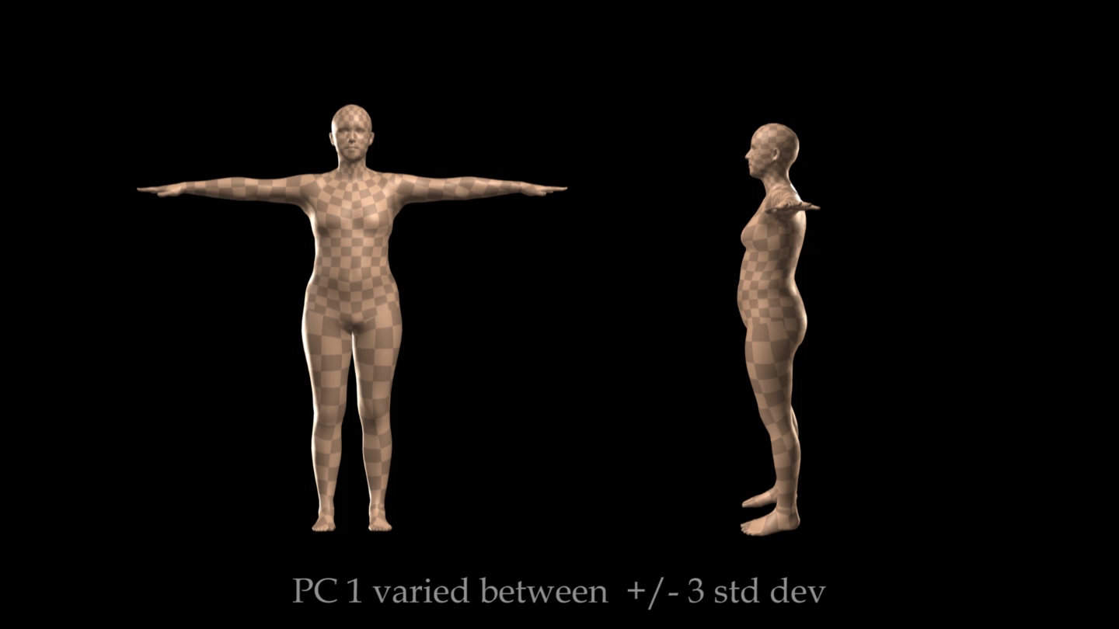
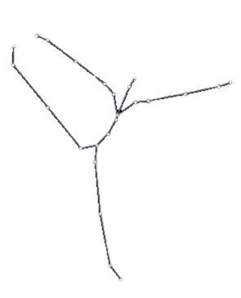
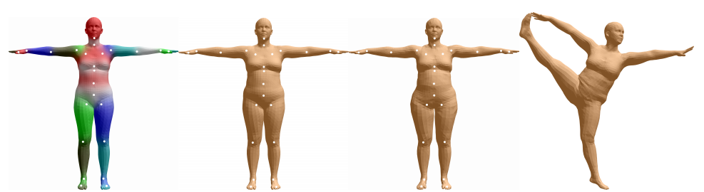


Our representation
Shape: PCA coefficients
Pose: Rotation of joints
Mesh
Camera
SMPL [Loper et al. SIGGRAPH ASIA ‘16]

Slide 45
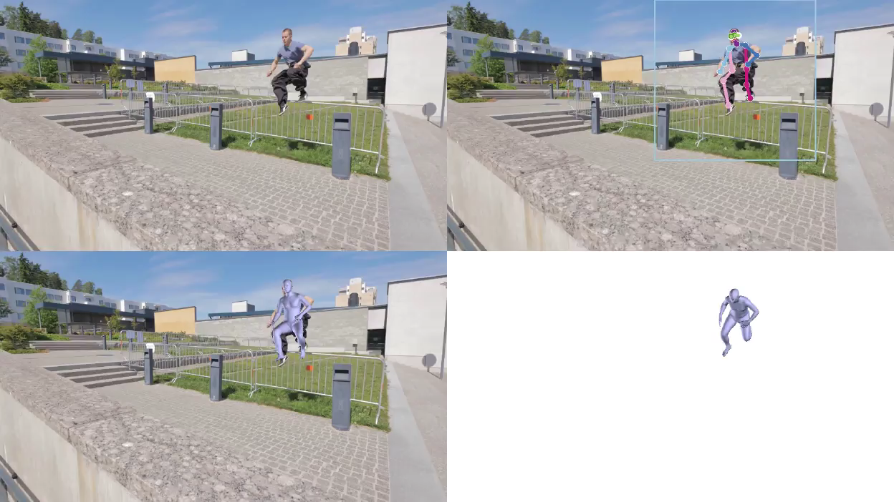

Slide 46
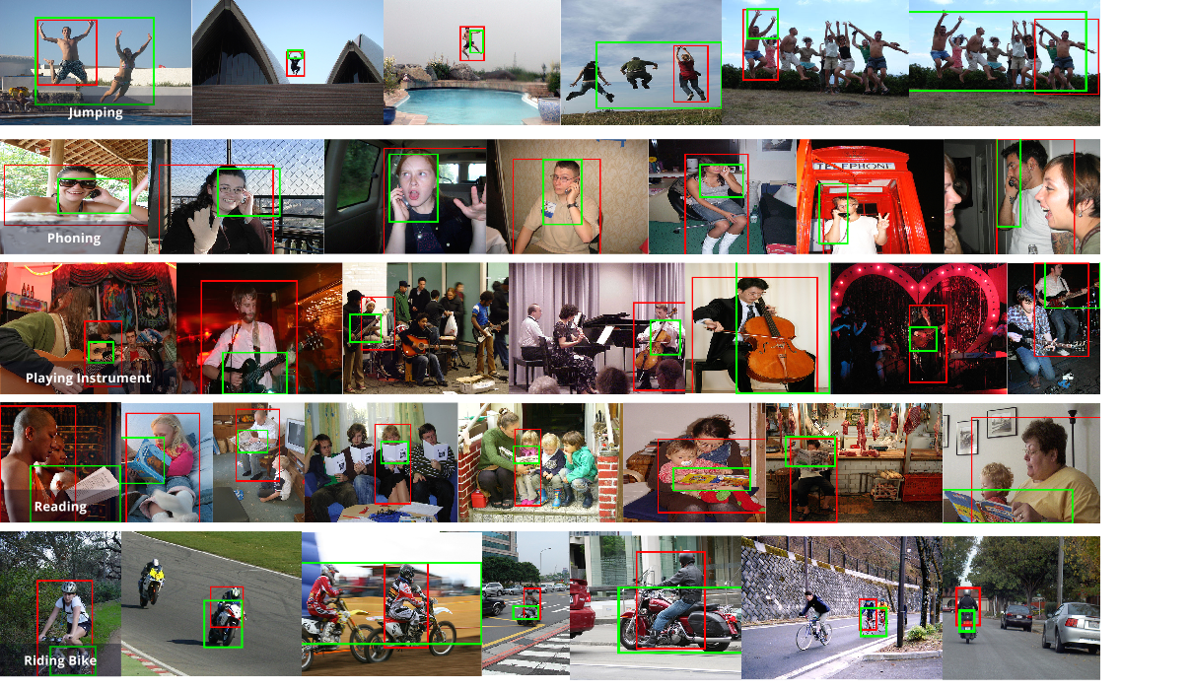
R*CNN (Gkioxari et al)

Slide 47
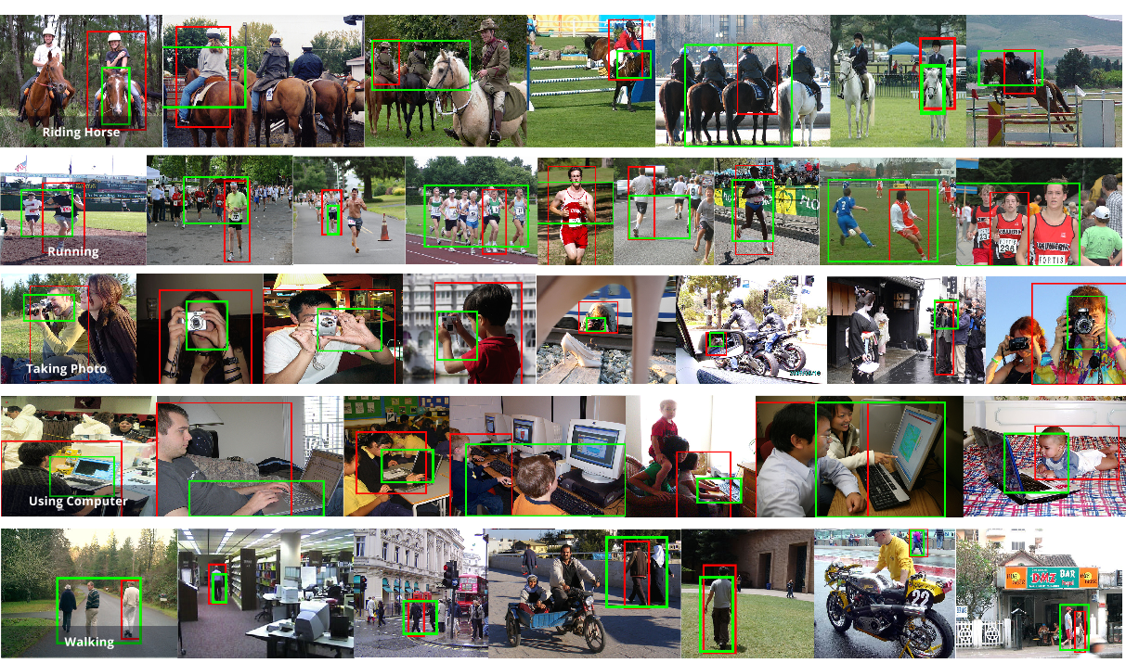
R*CNN on PASCAL VOC Action

Slide 48
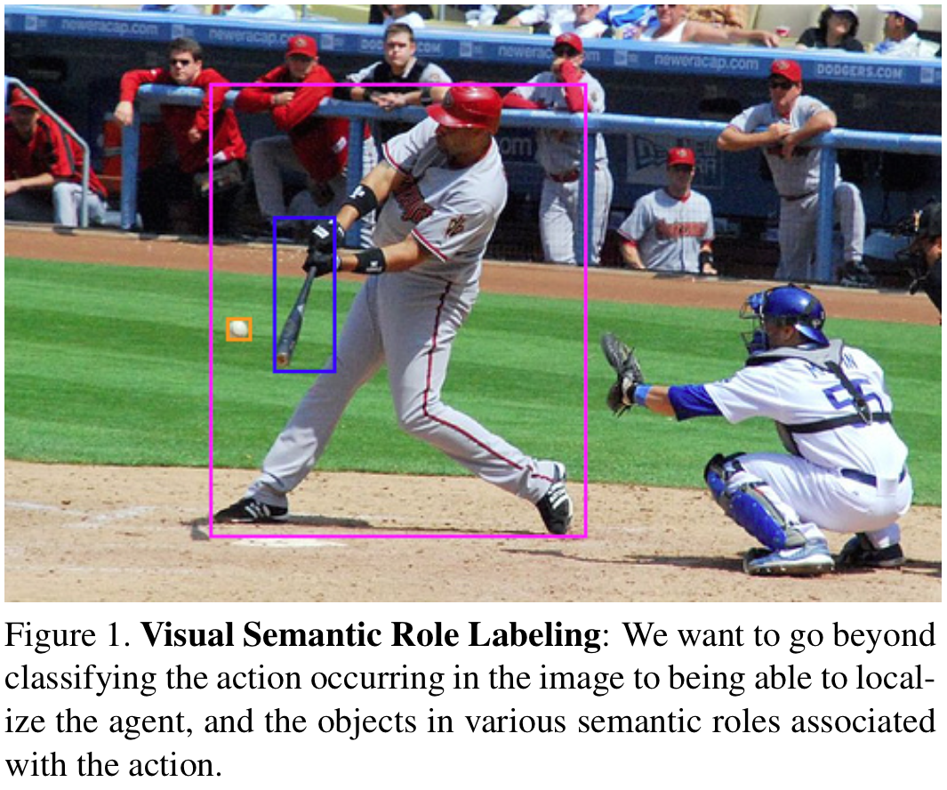
Visual Semantic Role Labeling Gupta & Malik (2015)

Slide 49
What we would like to infer…
Will person B put some money into Person C’s tip bag?

Slide 50
Social Perception
Computers today have pitifully low “social intelligence”
We need to understand the internal state of humans as they interact with each other and the external world
Examples: emotional state, body language, current goals.

Slide 51
What we can’t do (yet)
The hierarchical structure of human behavior- movement, goals, actions and events
ACTION = MOVEMENT + GOAL

Slide 52

On Mental Models
If the organism carries a `small-scale model’ of external reality and of its own possible actions within its head, it is able to try out various alternatives, conclude which is the best of them, react to future situations before they arise, utilize the knowledge of past events in dealing with the present and the future, and in every way to react in a much fuller, safer, and more competent manner to the emergencies which face it (Craik, 1943,Ch. 5, p.61)
Modern Control theory (Kalman et al) uses a state
space formalism to achieve this.

Slide 53
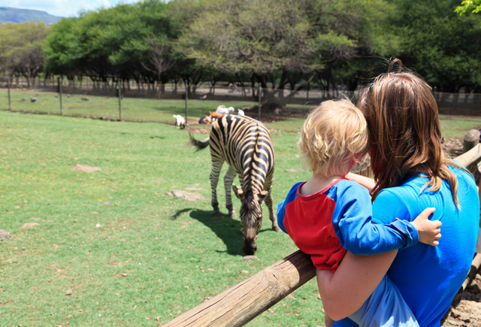
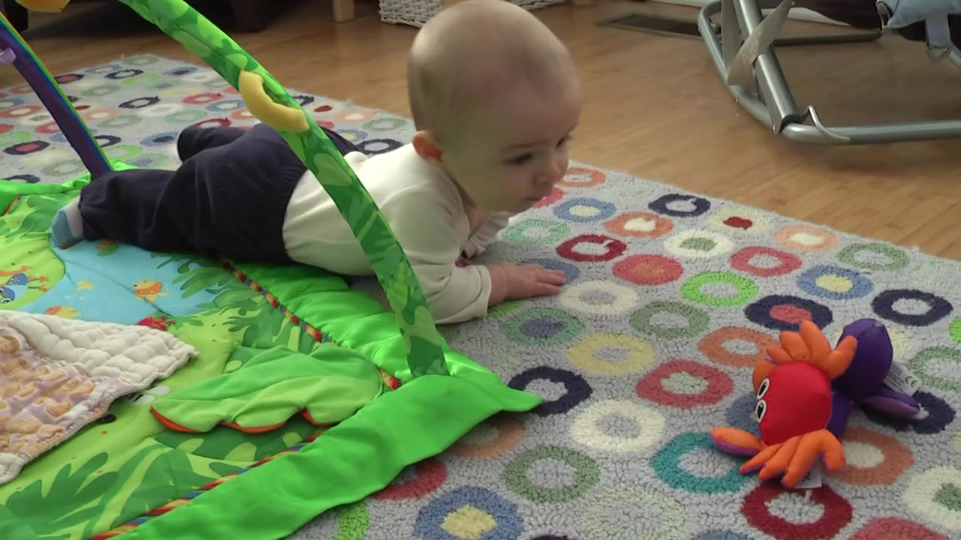
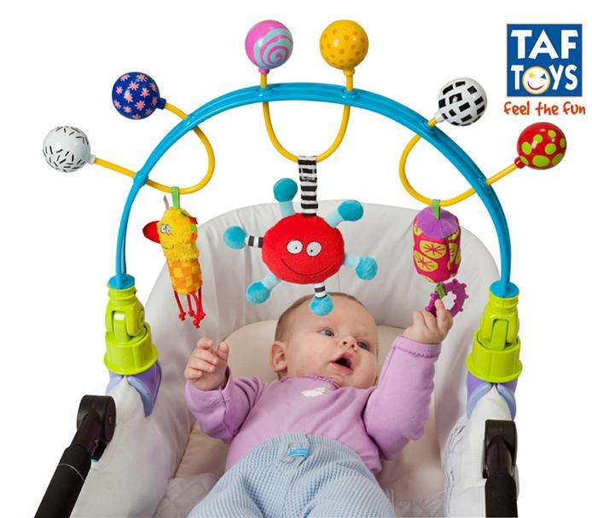
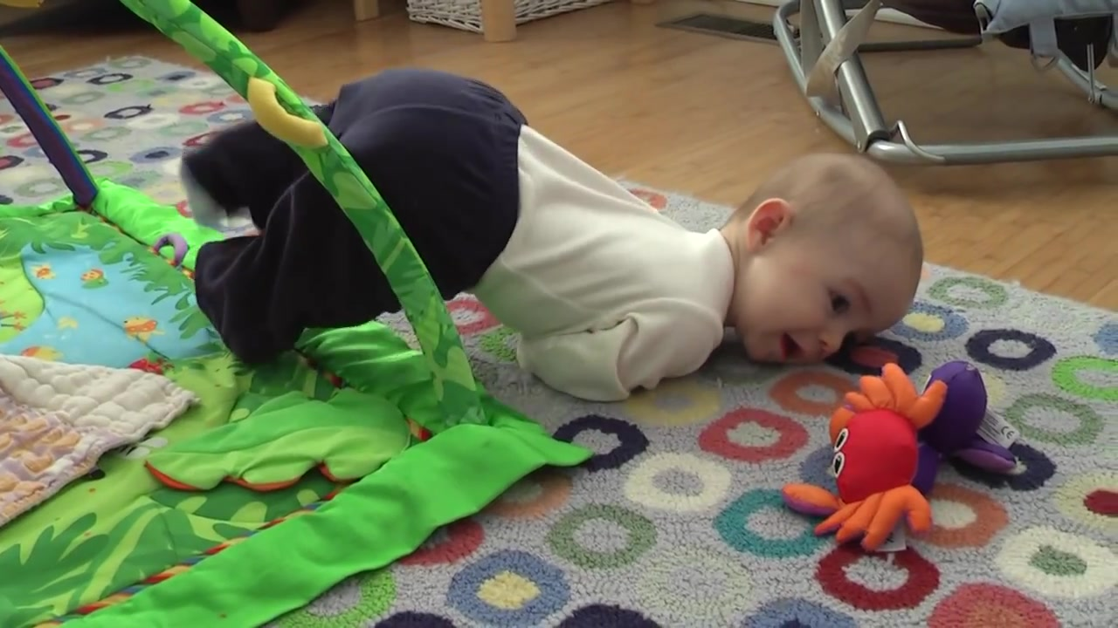
External Teacher Signal
External
Supervision
Internal
Teacher Signal
Self
Supervision

Slide 54
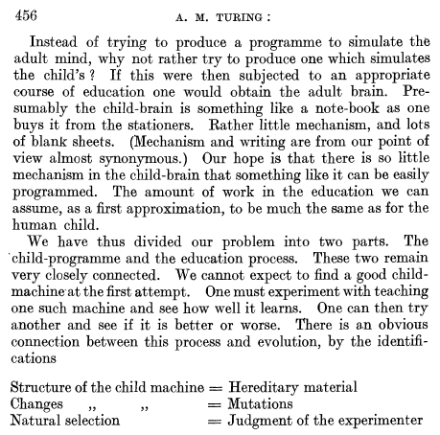
Computing Machinery and Intelligence Turing (1950)

Slide 55
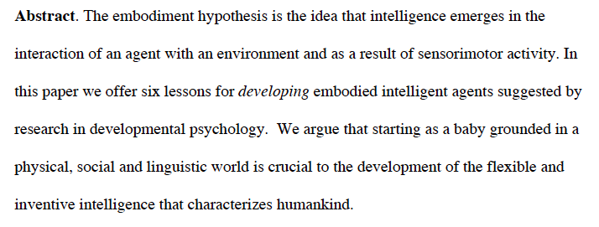
The Development of Embodied Cognition: Six Lessons from Babies Linda Smith & Michael Gasser

Slide 56
The Six Lessons
Be multi-modal
Be incremental
Be physical
Explore
Be social
Use language

Slide 57
We hope you enjoy the course!

